Slide 1

GANDHI INSTITUTE OF SCIENCE AND TECHNOLOGY KHOLIGUDA RAYAGADA SEMINAR : DATA SCIENCE
M.SATYA SAI CHOUDHURY
B.Tech FINAL YEAR CSE
REGD NO :1901317070

Slide 2


AGENDA

Slide 3






Slide 4

What is Data Science?
Data Science is the area of study which involves extracting insights from vast amounts of data using various scientific methods, algorithms, and processes. It helps you to discover hidden patterns from the raw data. The term Data Science has emerged because of the evolution of mathematical statistics, data analysis, and big data.
Data Science is an interdisciplinary field that allows you to extract knowledge from structured or unstructured data. Data science enables you to translate a business problem into a research project and then translate it back into a practical solution.

Slide 5

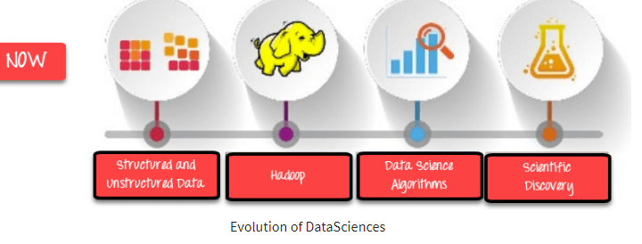
Why Data Science?
Data is the oil for today’s world. With the right tools, technologies, algorithms, we can use data and convert it into a distinct business advantage
Data Science can help you to detect fraud using advanced machine learning algorithms
It helps you to prevent any significant monetary losses
Allow to build intelligence ability in machines
You can perform sentiment analysis to gauge customer brand loyalty
It enables you to take better and faster decisions
It helps you to recommend the right product to the right customer to enhance your business

Slide 6
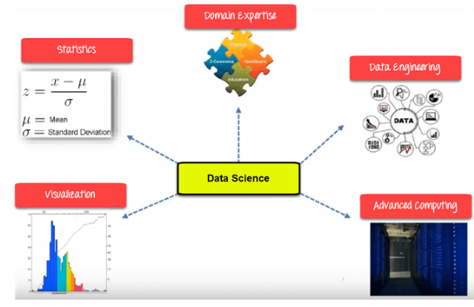
Data Science Components
Statistics
Visualization
Machine Learning
Deep Learning

Slide 7

Statistics
Statistics is the most critical unit of Data Science basics, and it is the method or science of collecting and analyzing numerical data in large quantities to get useful insights.
Statistics is a collection of principles and parameters the helps data scientists gain information about their data to make decisions when faced with uncertainty

Slide 8

Visualization
Visualization technique helps you access huge amounts of data in easy to understand and digestible visuals.
Data visualization is the process of creating interactive visuals to understand trends, variations, and derive meaningful insights from the data. Data visualization is used mainly for data checking and cleaning, exploration and discovery, and communicating results to business stakeholders.

Slide 9

Machine Learning
Machine Learning explores the building and study of algorithms that learn to make predictions about unforeseen/future data.
Machine learning (ML) is a statistical approach to studying and making inferences about data that utilizes a variety of algorithms suited for answering different types of questions. There are three main types of ML: supervised, unsupervised, and reinforcement learning.

Slide 10

Deep Learning
Deep learning defined Deep learning is a subset of machine learning (ML), where artificial neural networks—algorithms modeled to work like the human brain—learn from large amounts of data. How does deep learning work? Deep learning is powered by layers of neural networks, which are algorithms loosely modeled on the way human brains work.
This Photo by Unknown author is licensed under CC BY.

Slide 11
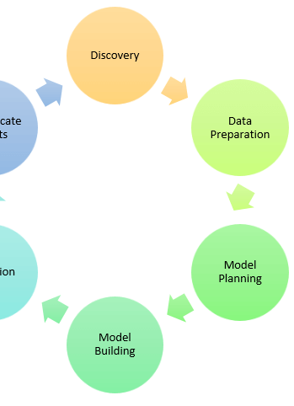
What is Data Science process
Frame the problem
Collect the raw data needed for your problem
Process the data for analysis
Explore the data
Perform in-depth analysis
Communicate results of the analysis

Slide 12

Discovery
Discovery step involves acquiring data from all the identified internal & external sources, which helps you answer the business question.
The data can be
Logs from webservers
Data gathered from social media
Census datasets
Data streamed from online sources using APIs

Slide 13

Preparation
Data can have many inconsistencies like missing values, blank columns, an incorrect data format, which needs to be cleaned. You need to process, explore and condition data before modelling. The cleaner your data, the better are your predictions.
When you’re ready to start data science, the first step is typically data preparation. Data preparation can involve various tasks, from cleaning and organizing your data to transforming it into the format you need.
If you’re starting, it’s important to remember that data preparation isn’t a one-time event. Instead, it’s a continuous process that you should continue throughout your data science journey.

Slide 14

Model Planning in Data Science
Model planning is phase 3 of lifecycle phases of data analytics, where team determines methods, techniques, and workflow it intends to follow for subsequent model building phase.
In this stage, you need to determine the method and technique to draw the relation between input variables. Planning for a model is performed by using different statistical formulas and visualization tools. SQL analysis services, R, and SAS/access are some of the tools used for this purpose.

Slide 15
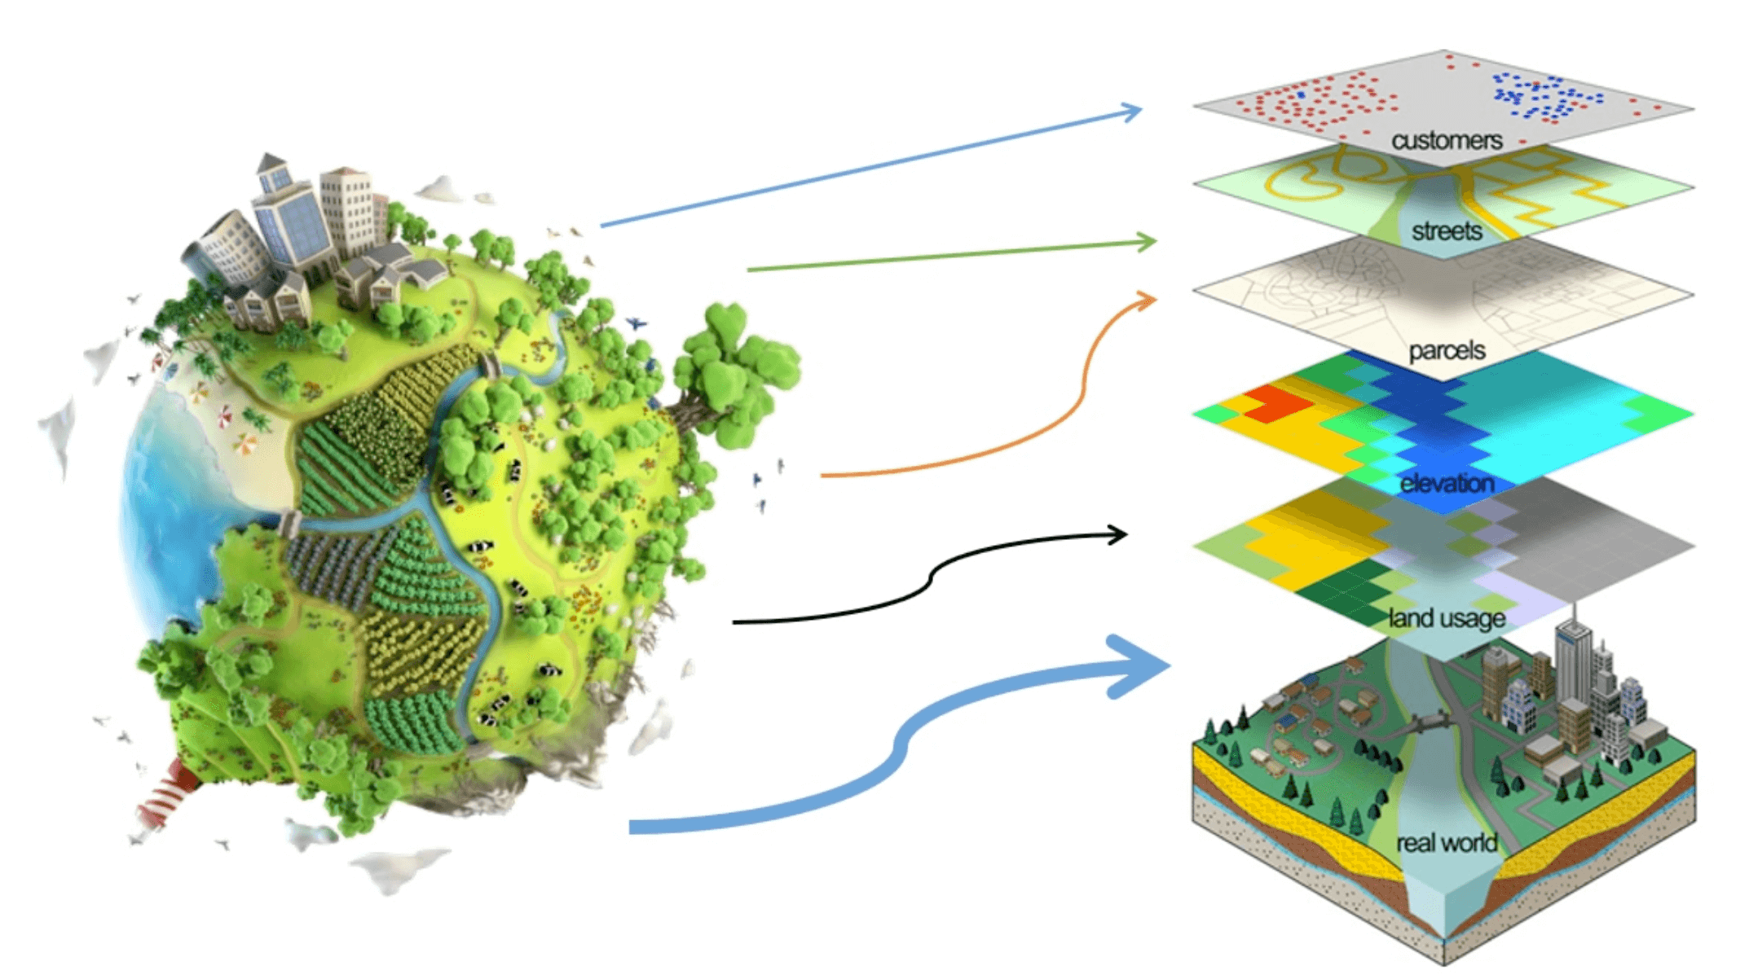
Model Building in Data Science
The model building process involves setting up ways of collecting data, understanding and paying attention to what is important in the data to answer the questions you are asking, finding a statistical, mathematical or a simulation model to gain understanding and make predictions.
The actual model building process starts. Here, Data scientist distributes datasets for training and testing. Techniques like association, classification, and clustering are applied to the training data set. The model, once prepared, is tested against the “testing” dataset.

